Slide 1
ONLINE BASED ATTENDENCE THROUGH FINGER PTINT SENSOR
BY
190040030 Rishitha Anumolu
190040170 G S S N V Brahmaji

Slide 2
INTRODUCTION
In industrial and domestic applications attendance registering is important at each and every moment. Many face a lot of problems due to lack of proper attendance monitoring system. In this project we use Fingerprint Sensor which senses the Fingerprint of a person.
In the World of Technology, Biometrics plays an effective role in identifying Human beings. Through this project, you will develop a unique system that can identify students for attendance purpose using their fingerprints.

Slide 3
INTODUCTION
This study has mainly focused to develop IOT based biometric attendance system, that is able to keep record of attendance and count the data for daily purpose. In this project we are going to design Fingerprint Sensor Based Biometric Attendance System using Arduino. Simply we will be interfacing fingerprint sensor with Arduino, LCD Display to design the desired project. In this project, we are using fingerprint Module and Arduino to take and keep attendance data and records.

Slide 4
COMPONENTS
Touch sensor
Arduino Uno
Lcd
Toggle
Arduino Software

Slide 5
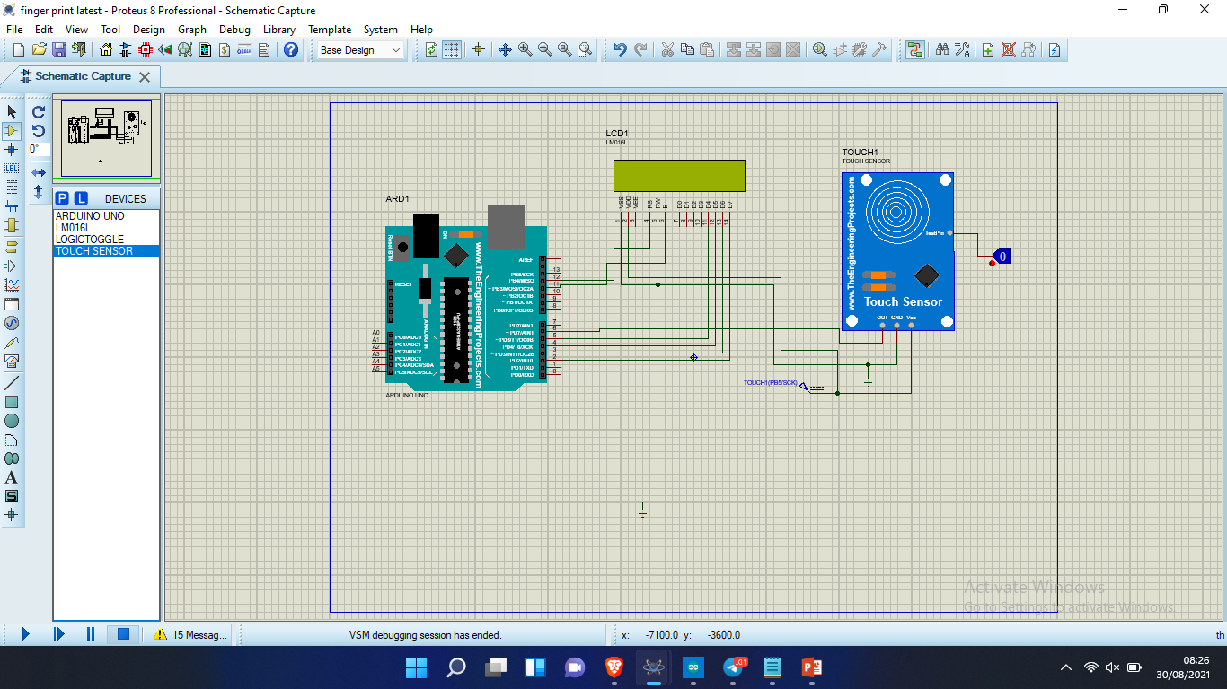
Circuit diagram

Slide 6
code
#include <LiquidCrystal.h>
const int rs = 12, en = 11, d4 = 5, d5 = 4, d6 = 3, d7 = 2;
LiquidCrystal lcd(rs, en, d4, d5, d6, d7);
int flag=1;
void setup() {
// put your setup code here, to run once:
lcd.begin(16,2);

Slide 7
lcd.begin(16,2);
lcd.print("Attendence Form");
lcd.setCursor(0,1);
lcd.print("started");
delay(200);
lcd.clear();
pinMode(6,INPUT);
}

Slide 8
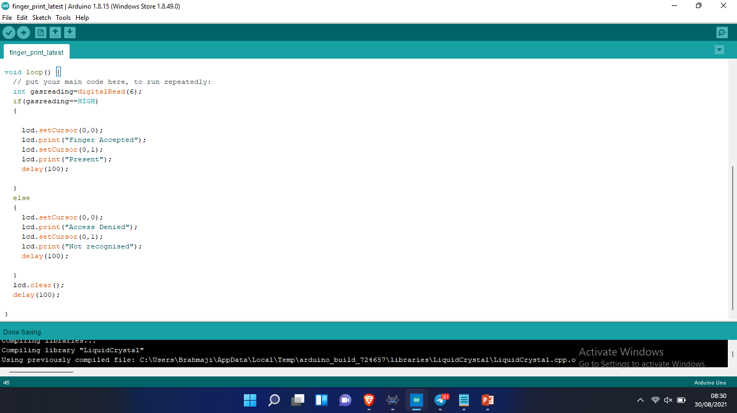
void loop() {
// put your main code here, to run repeatedly:
int toggle=digitalRead(6);
if(toggle==HIGH)
{
lcd.setCursor(0,0);
lcd.print("Finger Accepted");
lcd.setCursor(0,1);
lcd.print("Present");
delay(100);
}

Slide 9
else
{
lcd.setCursor(0,0);
lcd.print("Access Denied");
lcd.setCursor(0,1);
lcd.print("Not recognised");
delay(100);
}
lcd.clear();
delay(100);
}

Slide 10
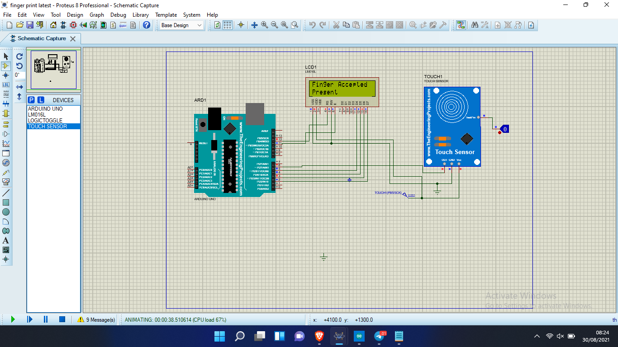
Circuit running pic

Slide 11
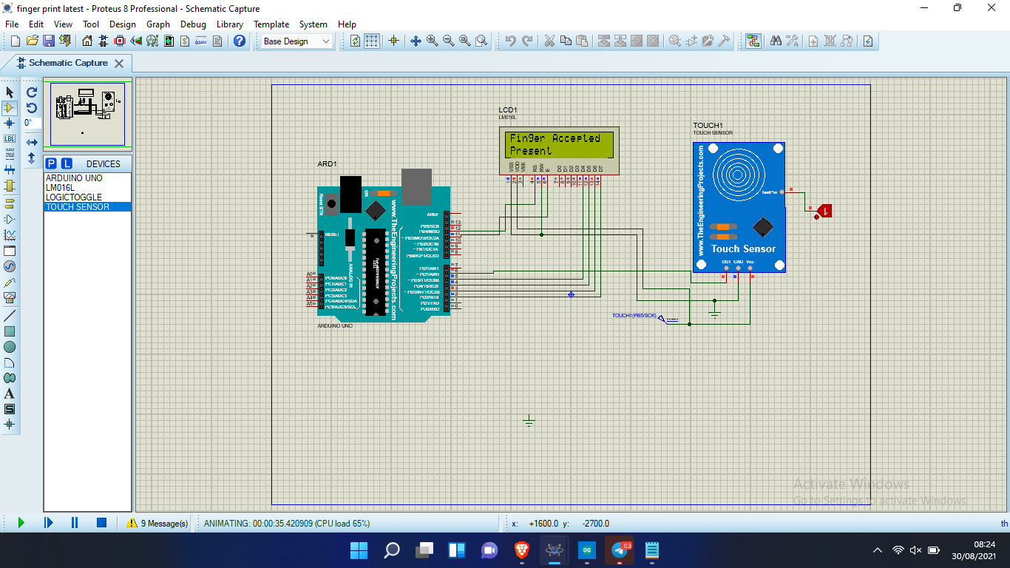
Output

Slide 12
Thank you!!!..

